Slide 1
Noise pollution
monitoring system

Slide 2
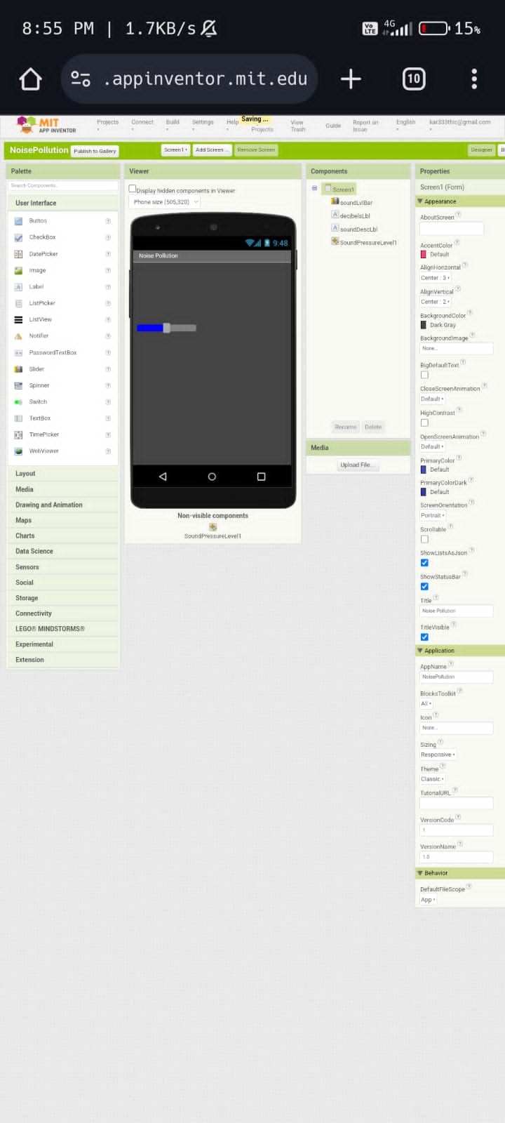
Design

Slide 3
The above design show A noise pollution monitoring system implemented with IoT technology and the MIT App Inventor program offers an innovative approach to address the growing concerns related to noise pollution in urban environments. This system combines hardware components, such as microphones or sound sensors, with MIT App Inventor's user-friendly interface for creating mobile applications.
The hardware sensors capture environmental noise levels and transmit data to an IoT device, typically using MQTT or other communication protocols. The MIT App Inventor program allows developers to design user-friendly and customizable mobile applications that receive this data in real-time. Users can access these apps on their smartphones or tablets to monitor noise pollution levels and receive alerts when noise exceeds predefined thresholds.

Slide 4
One of the key advantages of this approach is its accessibility. MIT App Inventor is a visual programming tool, making it accessible to individuals with varying levels of technical expertise. It empowers users to create tailored interfaces and interactive features for noise pollution monitoring, which can include data visualization, historical noise level records, and even geospatial mapping of noise hotspots.
Moreover, the data collected through this system can be analyzed and shared, facilitating research on noise pollution patterns and potential policy interventions. Overall, the combination of IoT and MIT App Inventor simplifies noise pollution monitoring, making it more accessible, interactive, and effective for both individuals and communities concerned about environmental noise levels.

Slide 5
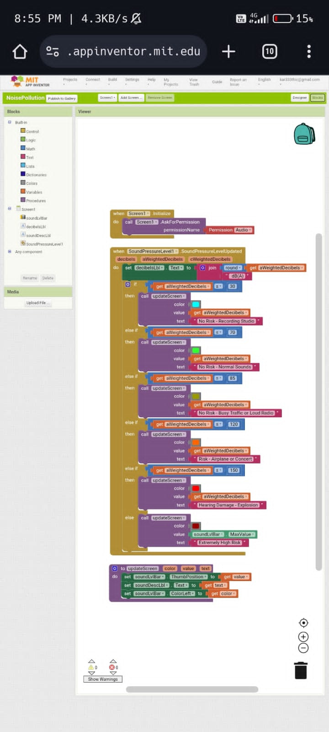
Blocks

Slide 6
Creating a complete noise pollution monitoring system using MIT App Inventor requires several components, and it's a relatively complex project
Design the App Interface:
Open MIT App Inventor.
Create a user interface with components such as labels, buttons, and a canvas.
Design the interface to display noise level data.

Slide 7
Connect to MQTT:
Add the "MQTT Client" component to your app.
Configure it with your MQTT broker details (server, port, username, password).
Subscribe to Noise Level Topic:
Use the "MQTT Client" component to subscribe to the MQTT topic where your IoT device sends noise level data.

Slide 8
Display Noise Level Data:
Create an event handler for when new messages arrive on the MQTT topic.
Parse the incoming data and update the interface (e.g., update a label with the noise level).
Alerts for Excessive Noise:
Implement logic to trigger alerts or notifications when noise levels exceed a certain threshold.

Slide 9
Data Logging and Visualization (Optional):
. You can add features to log historical noise data and visualize it on a chart or map.
Test and Deploy:
Test your app on an Android device using MIT App Inventor's live testing feature.
Once satisfied, you can package the app for distribution.

Slide 10
At its core, the MIT App Inventor program provides a user-friendly platform for designing mobile applications that can receive and display noise level data. The app interfaces are intuitive and customizable, making it easy for users to access and interpret real-time noise data. Users can effortlessly keep an eye on noise levels in their surroundings and stay informed about potential disturbances.
In conclusion, the integration of MIT App Inventor into the development of a noise pollution monitoring system represents a significant step towards addressing the challenges of noise pollution in today's urban environments. This approach offers a user-friendly, accessible, and data-driven solution that empowers individuals and communities to take control of their acoustic surroundings

